Slide 1
HOTEL AGGREGATOR ANALYSIS with POWER BI
1

Slide 2
INTRODUCTION
The hotel aggregator analysis project aims to analyze a dataset of hotel listings from a popular aggregator platforms.
The primary goal of the analysis is to derive actionable insights that can improve the competitiveness and quality of the listings on the platform.
INTRODUCTION
Project Overview

Slide 3
Objectives
Geographical Insights:
Explore the distribution of listings and host locations to identify popular neighborhoods and geographical trends.
2. Pricing and Availability Analysis:
Analyze pricing trends and availability patterns to understand market dynamics and identify peak periods.
3. Host Performance:
Evaluate host characteristics and their impact on listing performance, including response times, superhost status, and verification methods.
4. Review Scores and Guest Satisfaction:
Examine review scores and feedback to identify areas for improvement and enhance guest satisfaction.
5. Property Type and Room Analysis:
Analyze the distribution of property types and room types to understand preferences and trends among guests.

Slide 4
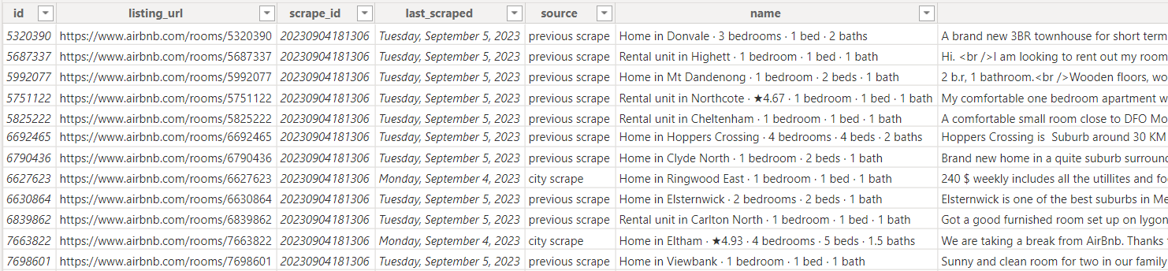
Hotel Aggregator Dataset
Dataset Columns Description
Id: Unique identifier for each listing.
listing_url: URL of the listing on the hotel aggregator platform.
scrape_id: Identifier for the data scraping event.
last_scraped: Date of the last data scrape.
source: Source of the listing information.
name: Name of the listing.
description: Description of the listing.
...
Dataset contains
23185 rows and 75 columns

Slide 5
Analysis Approach
The analysis of the hotel aggregator dataset follows a structured approach to ensure comprehensive insights are derived.
Data Cleaning
Handling missing values
Visualization
Power BI is employed to create interactive dashboards that facilitate data exploration
Exploratory Data Analysis (EDA)
uncover underlying patterns and trends.

Slide 6
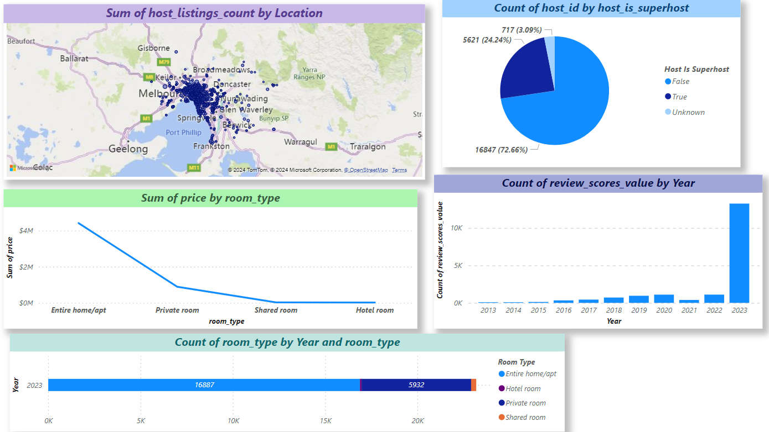
DASHBOARD OVERVIEW
6

Slide 7
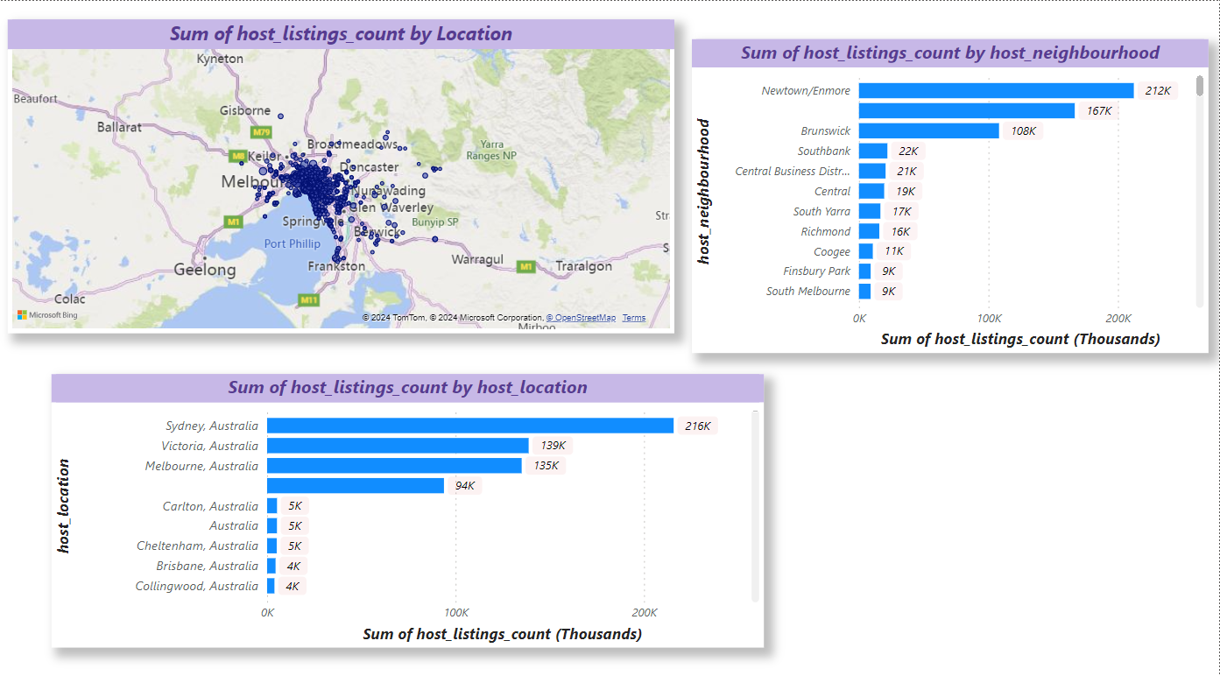
Geographical Insights Dashboard
The distribution of listings is located mostly in Melbourne, Australia
The analysis reveals a notable clustering of listings and host locations in Sydney
7

Slide 8
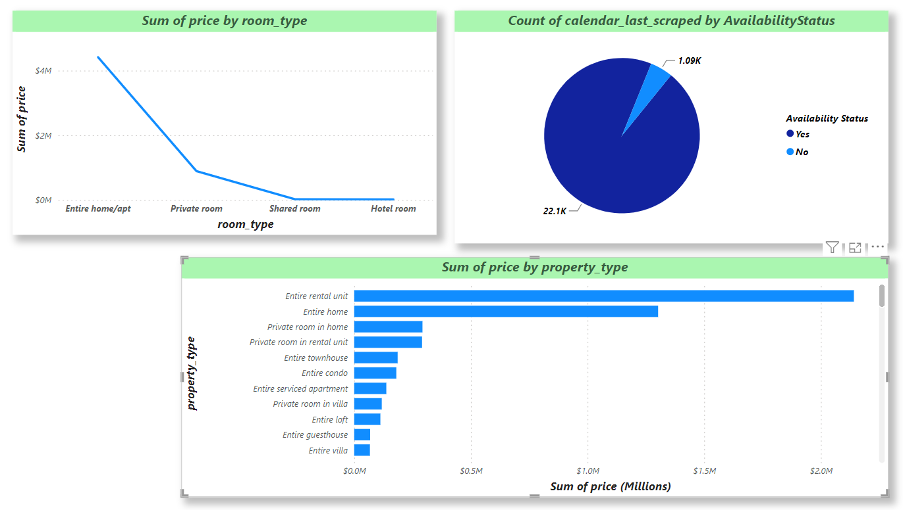
PRICING AND AVAILABILITY ANALYSIS
An entire rental unit is the most expensive property with price over $2m
According to the information retrieved recently the availability of booking is over 90%
8

Slide 9
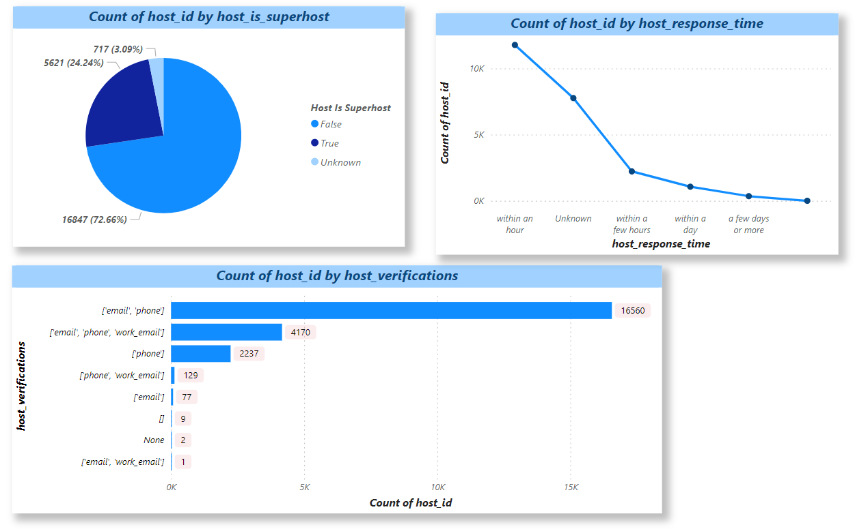
HOST PERFORMANCE DASHBOARD
Most hosts are Super Hosts with percentage of 73%
Almost 17K of Hosts prefer to verify themselves with email and phone number
The response time of most hosts is within an hour
9

Slide 10
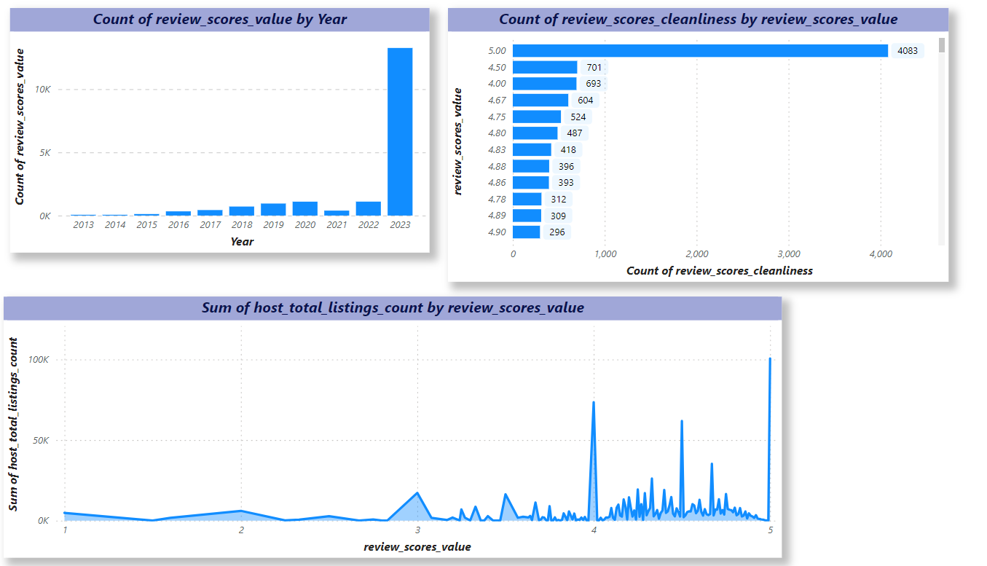
REVIEW SCORES AND GUEST SATISFACTION DASHBOARD
The review scores of users has increased over the last year (2023)
The higher the review score value the higher the listings
The cleaner and tidier the experience for the user the higher the review
10

Slide 11
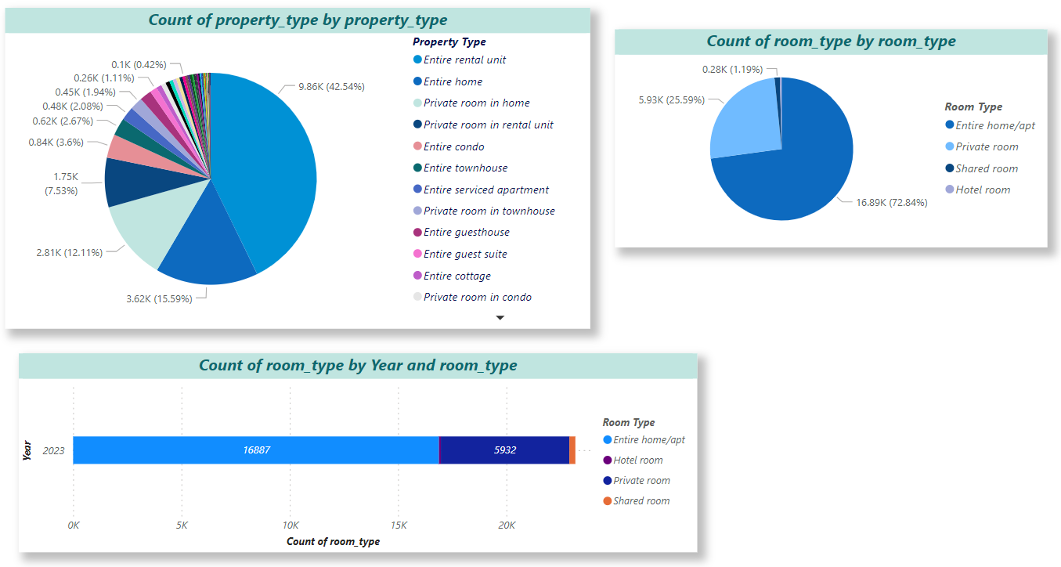
PROPERTY TYPE AND ROOM ANALYSIS DASHBOARD
The most popular property type is
an entire rental unit followed by an
entire home
According to the data gathered in 2023 users tend to choose when it comes to rooms, either an entire home/apt or a private room
11

Slide 12
CONCLUSION
The distribution of listings was concentrated particularly in Sydney and Melbourne.
Pricing trends varied based on property types, room types, and seasonal factors
Superhost status, quick response times, and thorough verification methods were found to positively influence listing performance
Review scores for cleanliness, accuracy, and communication were identified as critical factors impacting guest satisfaction
The analysis revealed changing trends in property types and room configurations
Pricing and Availability
Review Scores and Guest Satisfaction
Property Type and Room Analysis
Geographical Insights
Host Performance

Slide 13
SUMMARY
The analysis of the hotel aggregator dataset provided valuable insights into various aspects of the listings, hosts, and guest experiences and through it we can give recommendations such Enhancing Geographical Diversity, Optimizing Pricing Strategies, Invest in Host Training: Offer training programs and resources to help hosts improve their performance
SUMMARY

Slide 14
THANK you
14

